Slide 1

Reinforcement Learning
Learning to play games…
and live in a complex world
Yordan Darakchiev
Technical Trainer
iordan93@gmail.com

Slide 2
sli.do
#DeepLearning

Slide 3
Table of Contents
Problem description
Approaches
Deep-Q networks
AlphaGo
"Specification gaming"

Slide 4
Reinforcement Learning
Main points

Slide 5
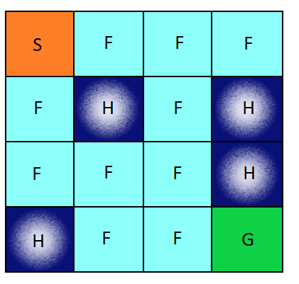
OpenAI Gym
Install the Python library
Usage
Goal: Reach cell G
  Environment description
  Slight complication:
  you don’t always go in the
  direction you're trying to go
conda install -c conda-forge gym
import gym
environment = gym.make("FrozenLake-v0")

Slide 6
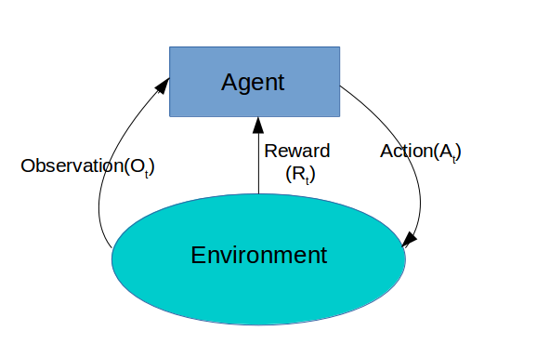
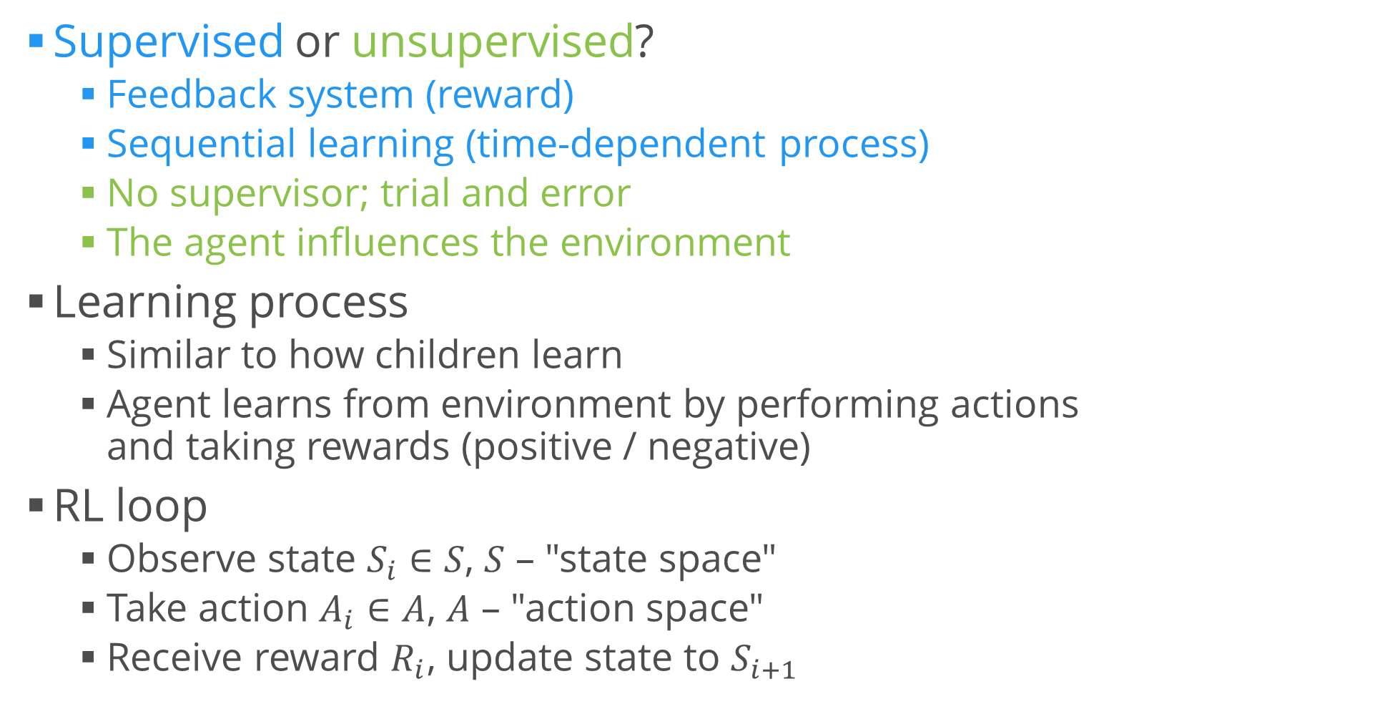
Reinforcement Learning
Supervised or unsupervised?
  Feedback system (reward)
  Sequential learning (time-dependent process)
  No supervisor; trial and error
  The agent influences the environment
Learning process
  Similar to how children learn
  Agent learns from environment by performing actions
  and taking rewards (positive / negative)
RL loop
  Observe state $S_{i}∈S$, $S$ – "state space"
  Take action $A_{i}∈A$, $A$ – "action space"
  Receive reward $R_{i}$, update state to $S_{i+1}$

Slide 7
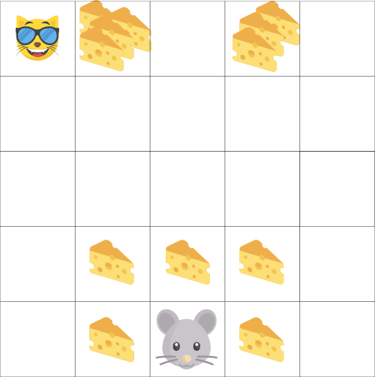
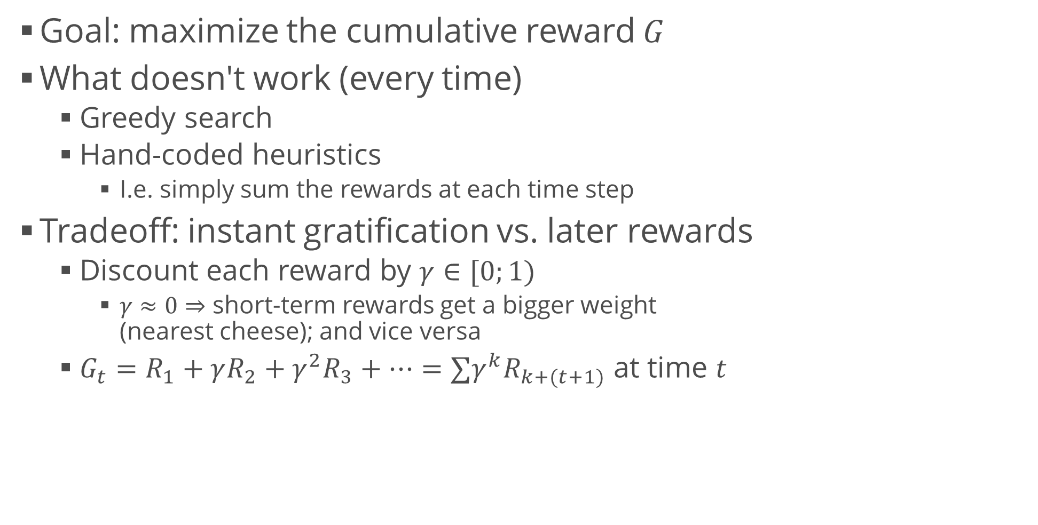
Reinforcement Learning (2)
Goal: maximize the cumulative reward $G$
What doesn't work (every time)
  Greedy search
  Hand-coded heuristics
    I.e. simply sum the rewards at each time step
Tradeoff: instant gratification vs. later rewards
  Discount each reward by $γ∈[0;1)$
    $γ≈0⇒$ short-term rewards get a bigger weight
    (nearest cheese); and vice versa
  $G_{t}=R_{1}+γR_{2}+γ^{2}R_{3}+…=∑γ^{k}R_{k+(t+1)}$ at time $t$

Slide 8
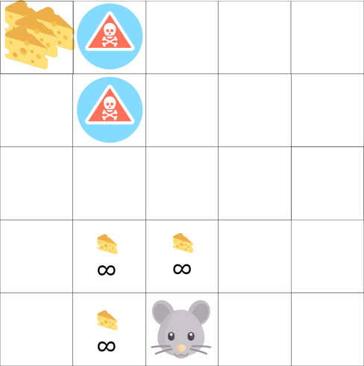
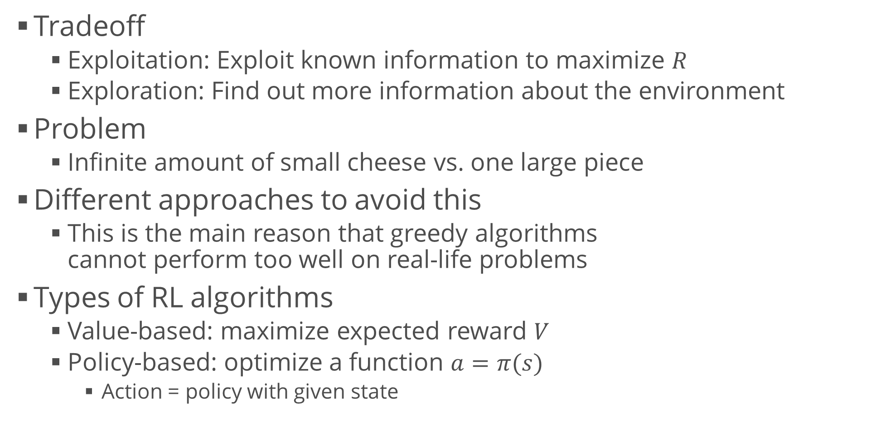
Exploration / Exploitation Tradeoff
Tradeoff
  Exploitation: Exploit known information to maximize $R$
  Exploration: Find out more information about the environment
Problem
  Infinite amount of small cheese vs. one large piece
Different approaches to avoid this
  This is the main reason that greedy algorithms
  cannot perform too well on real-life problems
Types of RL algorithms
  Value-based: maximize expected reward $V$
  Policy-based: optimize a function $a=π(s)$
    Action = policy with given state

Slide 9
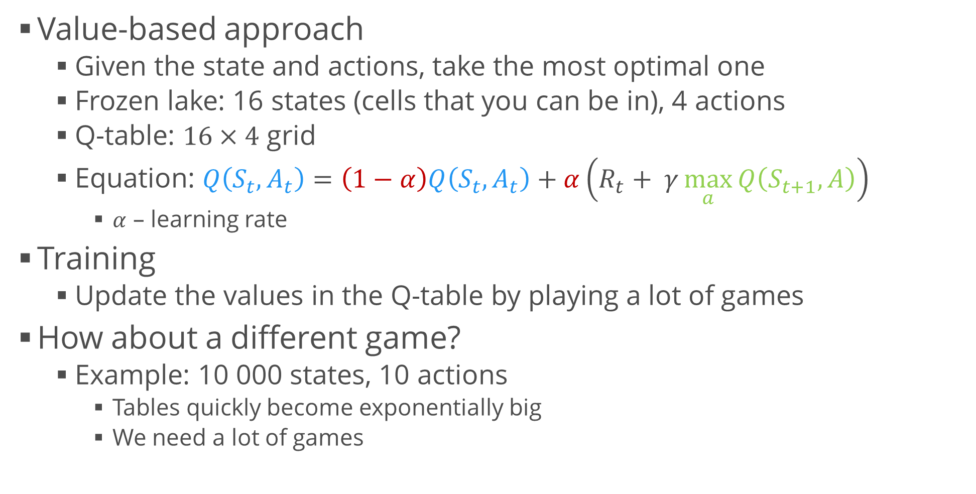
Q-Learning
Value-based approach
  Given the state and actions, take the most optimal one
  Frozen lake: 16 states (cells that you can be in), 4 actions
  Q-table: $16×4$ grid
  Equation: $Q\left(S_{t},A_{t}\right)=\left(1−α\right)Q\left(S_{t},A_{t}\right)+α\left(R_{t}+ γ\max_{a}{Q\left(S_{t+1},A\right)}\right)$
    $α$ – learning rate
Training
  Update the values in the Q-table by playing a lot of games
How about a different game?
  Example: 10 000 states, 10 actions
    Tables quickly become exponentially big
    We need a lot of games

Slide 10
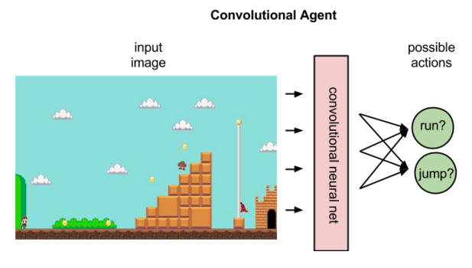
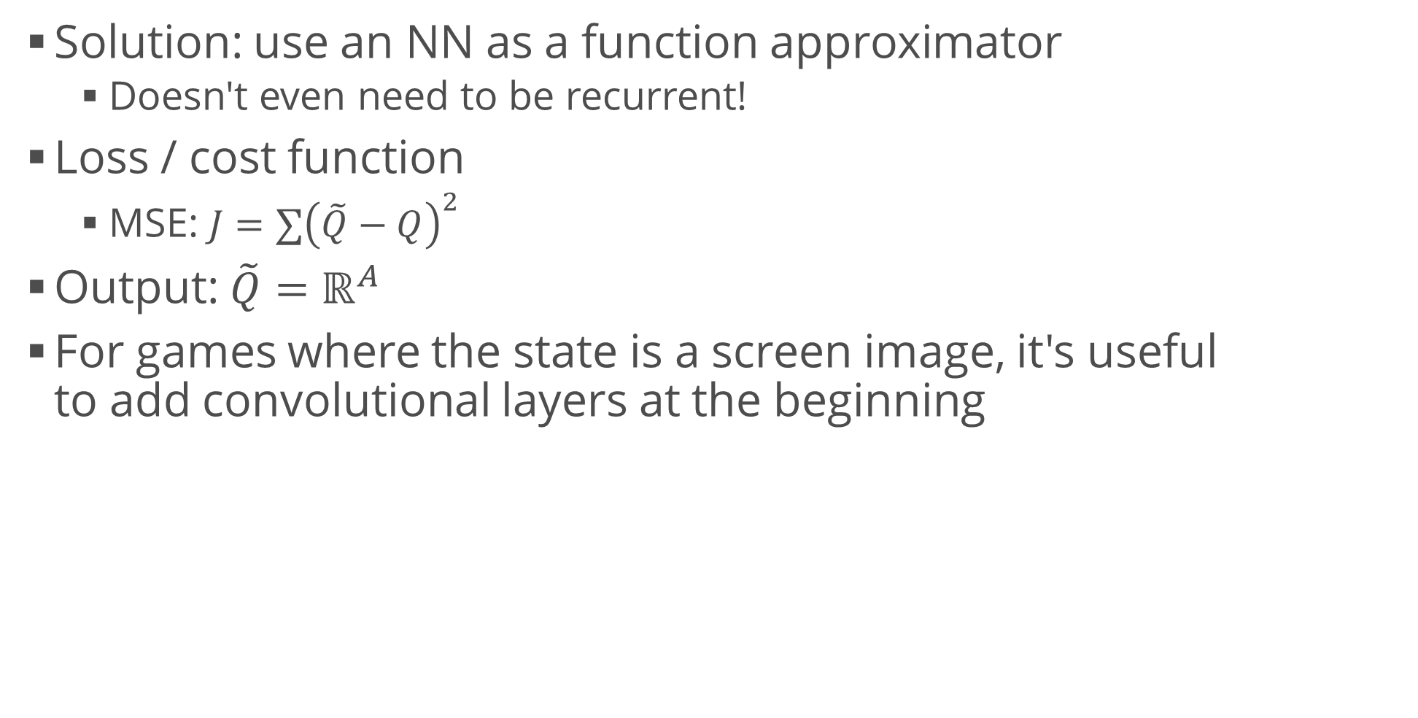
Deep Q-Learning
Solution: use an NN as a function approximator
  Doesn't even need to be recurrent!
Loss / cost function
  MSE: $J=∑{\left(\tilde{Q}−Q\right)}^{2}$
Output: $\tilde{Q}=ℝ^{A}$
For games where the state is a screen image, it's useful
to add convolutional layers at the beginning

Slide 11
Playing Games
AlphaGo and its variations

Slide 12
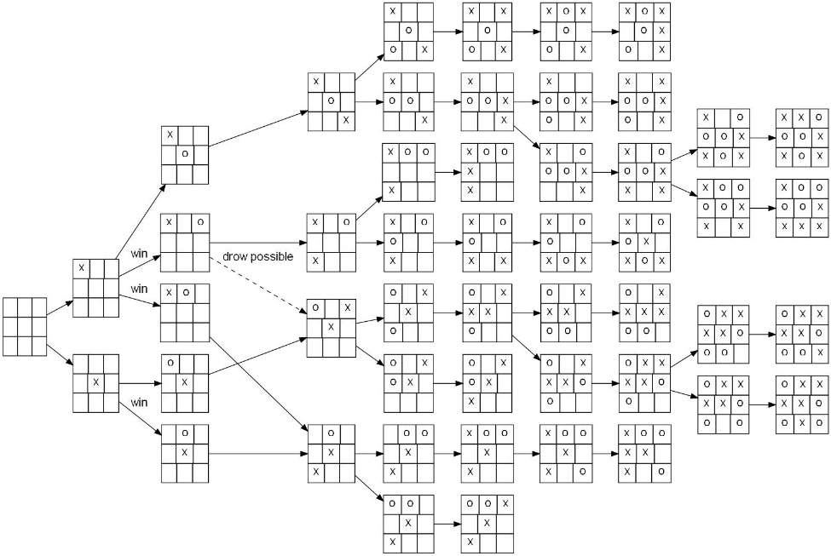
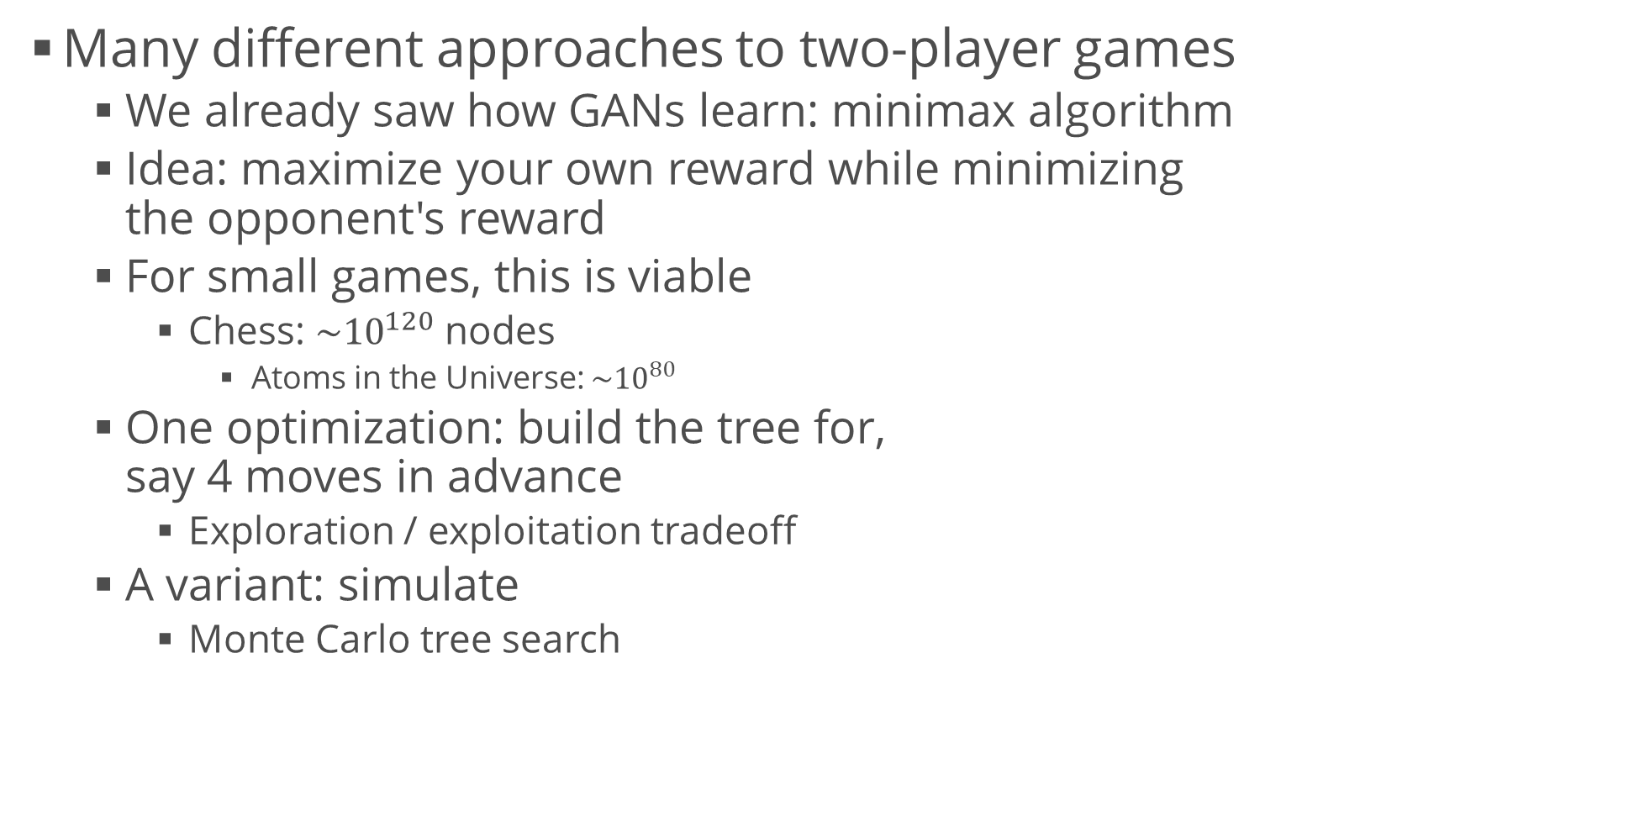
Two-player Games
Many different approaches to two-player games
  We already saw how GANs learn: minimax algorithm
  Idea: maximize your own reward while minimizing
  the opponent's reward
  For small games, this is viable
    Chess: $\sim {10}^{120}$ nodes
      Atoms in the Universe: $\sim {10}^{80}$
  One optimization: build the tree for,
  say 4 moves in advance
    Exploration / exploitation tradeoff
  A variant: simulate
    Monte Carlo tree search

Slide 13
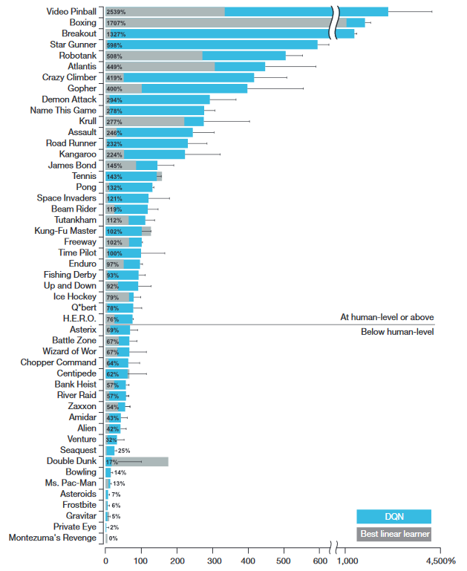
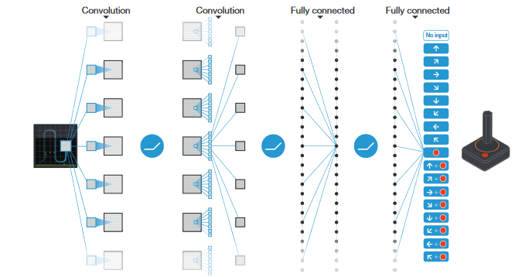
Deep-Q Networks
Mnih et al., 2013; Mnih et al., 2015

Slide 14

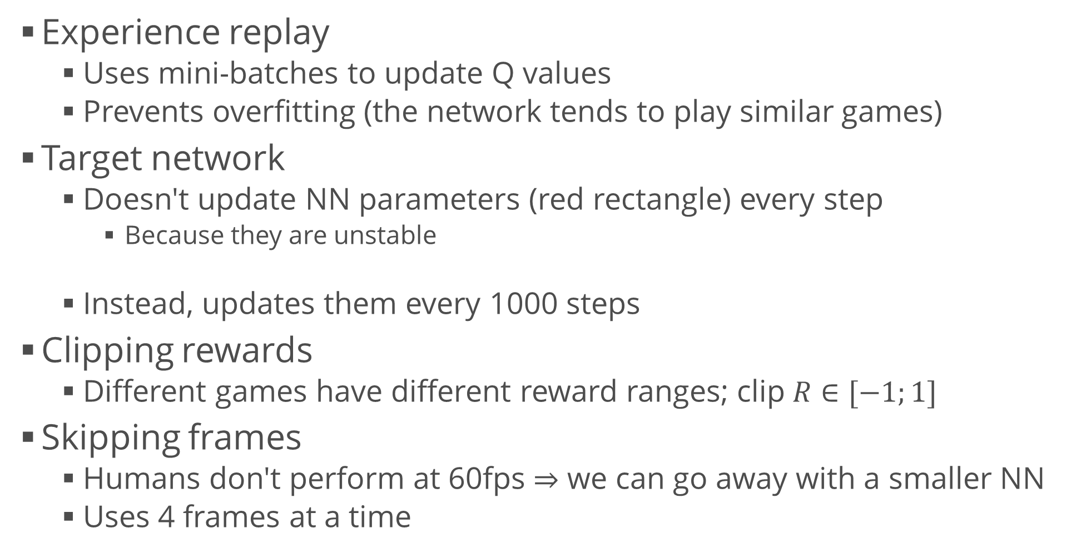
AlphaGo
Experience replay
  Uses mini-batches to update Q values
  Prevents overfitting (the network tends to play similar games)
Target network
  Doesn't update NN parameters (red rectangle) every step
    Because they are unstable
  Instead, updates them every 1000 steps
Clipping rewards
  Different games have different reward ranges; clip $R∈[−1;1]$
Skipping frames
  Humans don't perform at 60fps $⇒$ we can go away with a smaller NN
  Uses 4 frames at a time

Slide 15
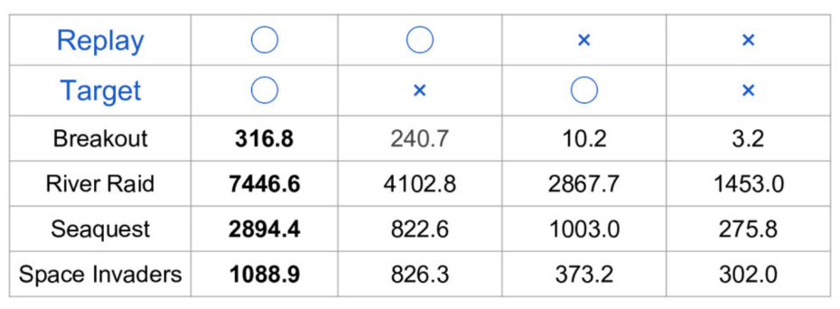
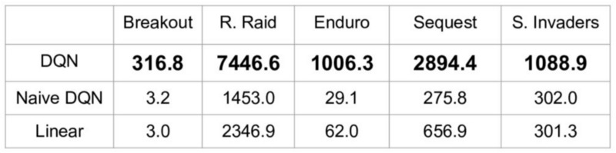
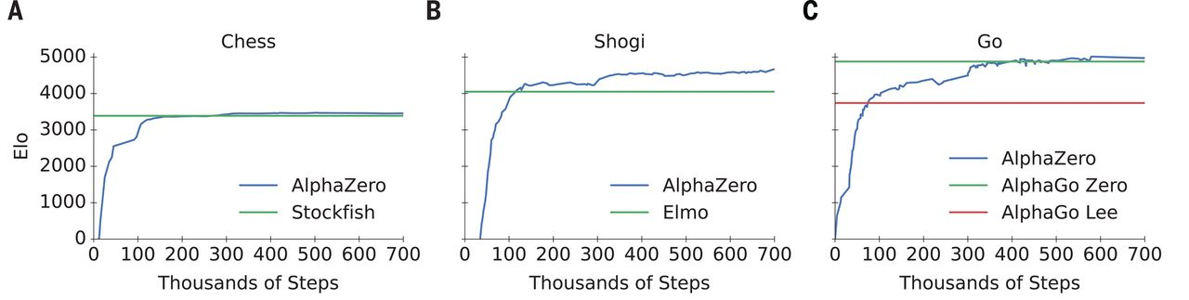
AlphaGo (2)
Performance w.r.t. experience replay / target network
Results (2015)
Silver et al., Science, 07.12.2018

Slide 16
Applications of DQNs
Snake
Small board games (AlphaToe)
CNNs for OpenAI Gym
LSTMs with attention
DeepMind's DQN papers
  Silver et al., 2017: AlphaGo Zero
A3C algorithm, tensorflow

Slide 17
State of RL
Key RL papers
  Pay attention to "12. Reproducibility, Analysis, and Critique"
Notes on important papers
NeurIPS 2020 (videos, workshop)
Overview of deep RL algorithms (Ivanov, 2019)
Some interesting applications
  Text summarization (Paulus et al., 2017)
  Traffic control (Guo & Wang, 2019)
  Molecular dynamics (Zhou et al., 2019)
  Recommenders (online ads), Zhao et al., 2019
  Autonomous driving (Kiran et al., 2021)
  Robotics / drones (Yan et al., 2021)

Slide 18
"Specification gaming"
Source
  OpenAI article
  The hardest step in optimization is to choose the correct
  reward function
  A wrongly or poorly chosen reward tends to create algorithms
  which cheat
Examples
  Creatures bred for speed grow really tall and generate high
  velocities by falling over
  Simulated pancake making robot learned to throw the pancake as high in the air as possible in order to maximize time away from the ground
  Agent kills itself at the end of level 1 to avoid losing in level 2
  Self-driving car rewarded for speed learns to spin in circles
  Agent pauses the game indefinitely to avoid losing

Slide 19
Summary
Problem description
Approaches
Deep-Q networks
AlphaGo
"Specification gaming"

